Slide 1
Improving Seminar Wargaming Tool jSWAT
UNCLASSIFIED
Lance Holden
Land Simulation, Experimentation and Wargaming, DST Group
Notes:
Introduce self, co-authors, organisation and paper.
Introduction on work:
One of our functions is to analyse the complex domain of close combat and to provide reports on the impact of changes in equipment or strategy. To support this we use a series of combat simulation tools to provide evidence for analysis. These simulation tools often have complex data requirements.

Slide 2
Introduction
UNCLASSIFIED
Overview
Seminar Wargaming
jSWAT
Improvements

Slide 3
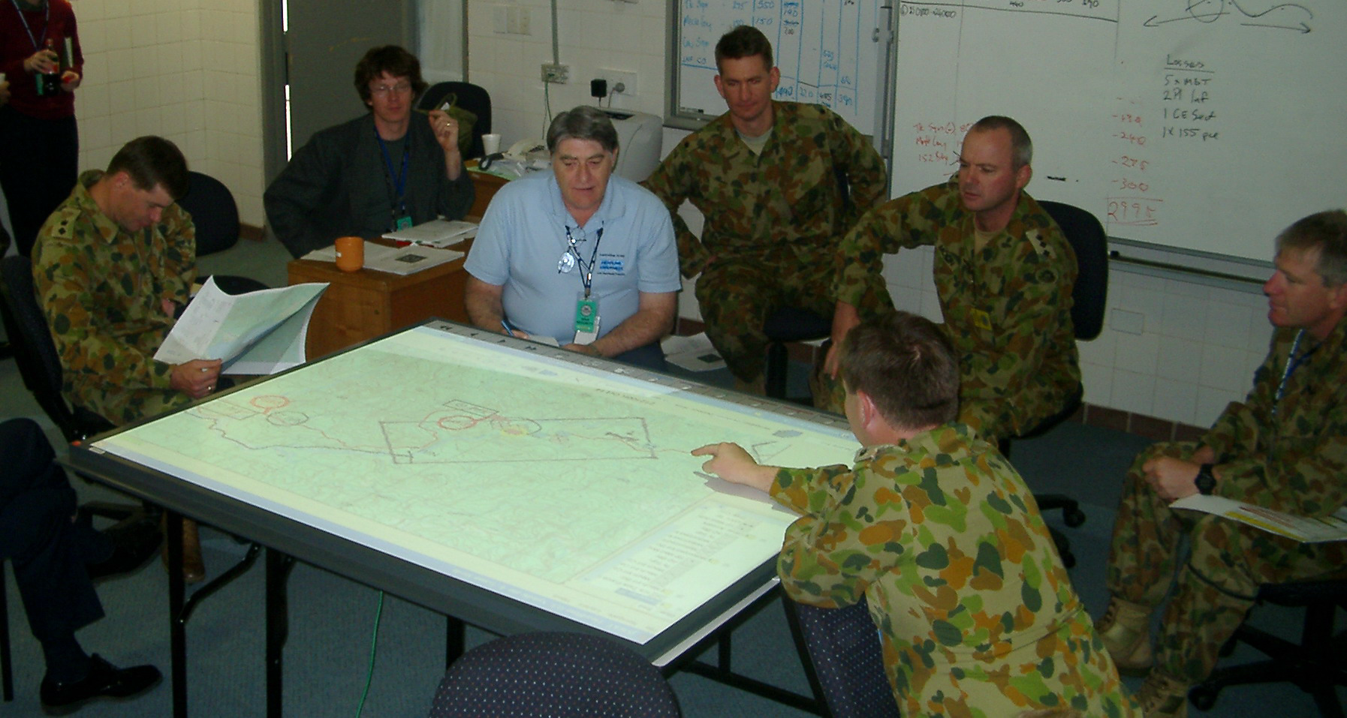
Seminar Wargaming
UNCLASSIFIED
Red Commander
Analysts
BOS Staff
Adjudicator
Blue Commander
Round-table game (with shared map)

Slide 4
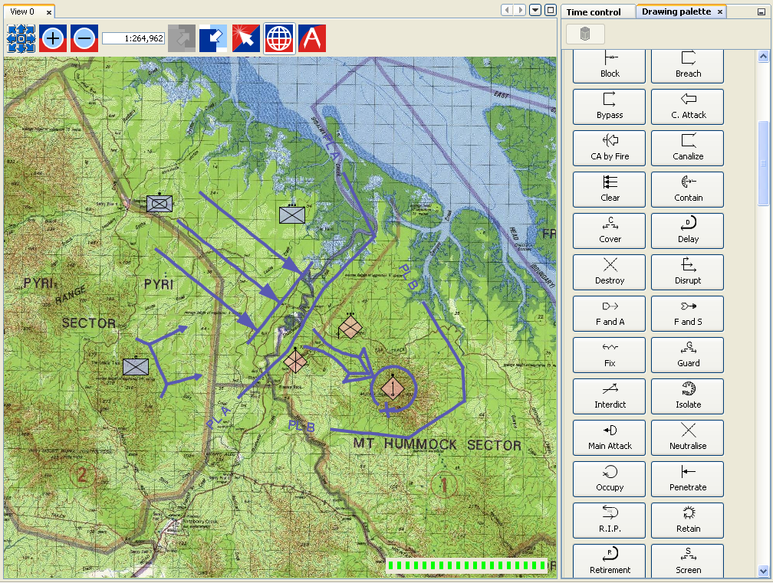
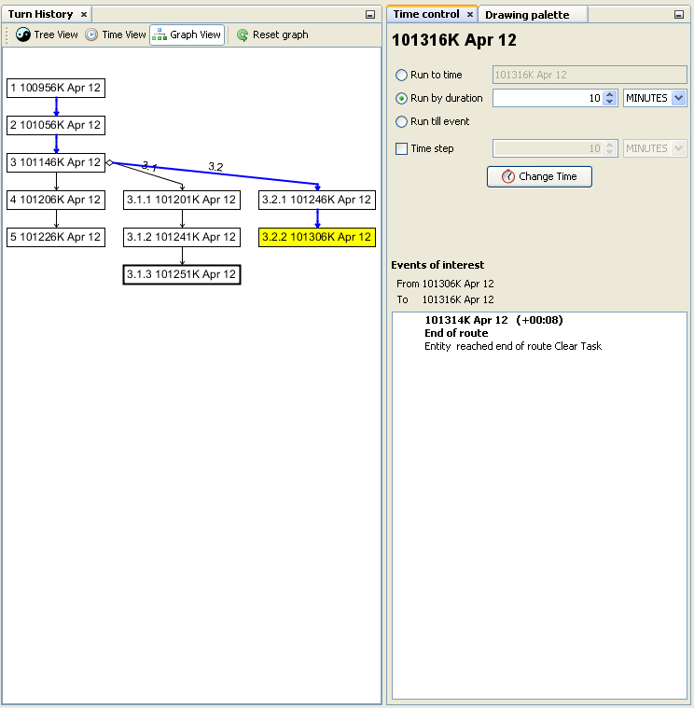
jSWAT
UNCLASSIFIED
joint Seminar Wargame Adjudication Tool
Notes:
Overview slide, will be replace with actual 5 minute or less jSWAT demonstration of icon movement, graphics and turn history.

Slide 5
Goal
UNCLASSIFIED
Keep and view all game state data

Slide 6
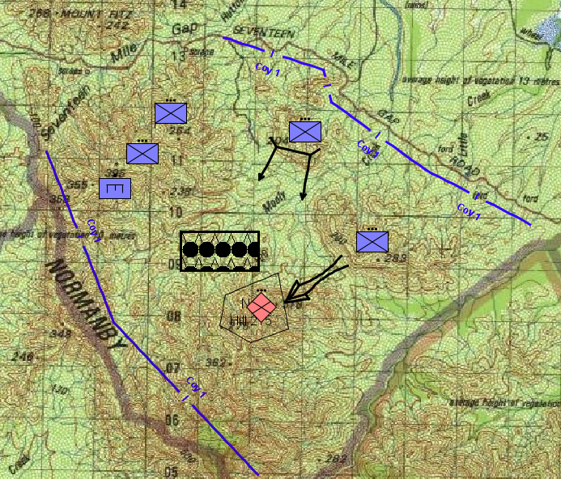
Data
UNCLASSIFIED
Unversioned
Turn 1.1
Current Data
Plans
ORBAT
Wargame

Slide 7
Data
UNCLASSIFIED
Unversioned
Turn 1.1
Current Data

Slide 8
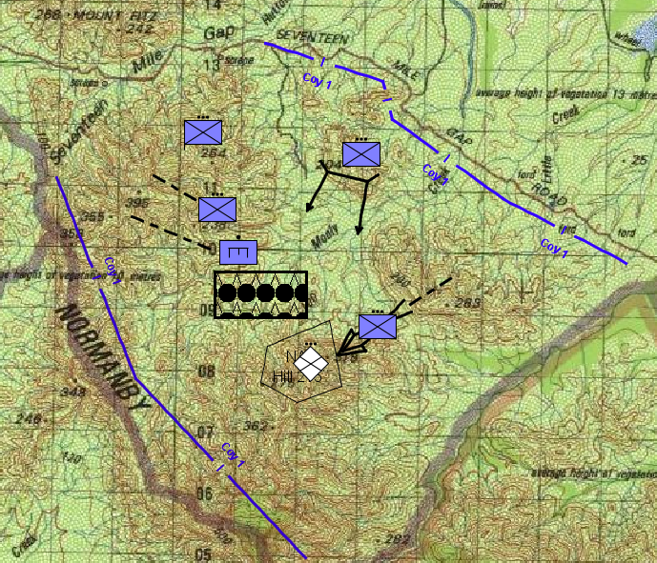
Data
UNCLASSIFIED
Unversioned
Current Data
Turn 1.1

Slide 9
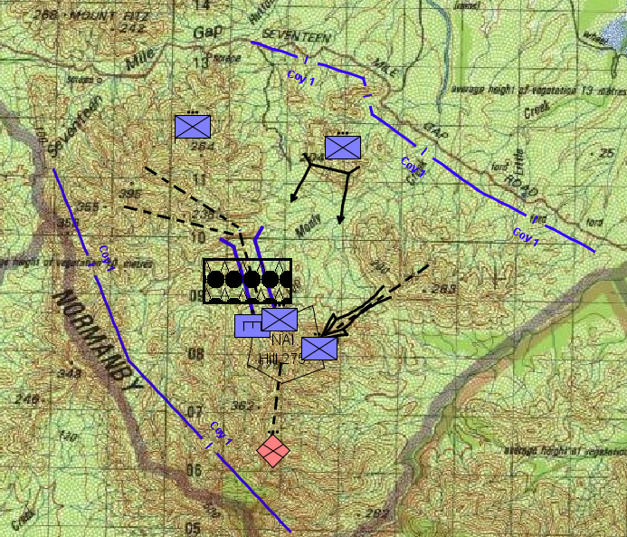
Data
UNCLASSIFIED
Unversioned
Current Data
Turn 1.2
Turn 1.1

Slide 10
Data
UNCLASSIFIED
Unversioned
Current Data
Turn 1.1
Turn 1.2
Go Back

Slide 11
Data
UNCLASSIFIED
Unversioned
Current Data
Needs Improvement
Lost
Turn 1.1
Turn 1.2

Slide 12
Data - View
UNCLASSIFIED
Unversioned
Current Data
Turn 1.1
Turn 1.2

Slide 13
Data - View
UNCLASSIFIED
Unversioned
Current Data
Turn 1.1
Turn 1.2

Slide 14
Data - View
UNCLASSIFIED
Unversioned
Current Data
Needs Improvement
Turn 1.1
Turn 1.2

Slide 15
Data Stacks
UNCLASSIFIED
Plan
ORBAT
Wargame

Slide 16
Data Stacks
UNCLASSIFIED
Plan
ORBAT
Wargame

Slide 17
Data Stacks
UNCLASSIFIED
Plan
ORBAT
Wargame

Slide 18
Data Stacks
UNCLASSIFIED
Plan
ORBAT
Wargame

Slide 19
Data Stacks
UNCLASSIFIED
Plan
ORBAT
Wargame

Slide 20
Data Stacks
UNCLASSIFIED
Wargame
t0
Event A
Event B
tn

Slide 21
Data Stacks
UNCLASSIFIED
Plan
ORBAT
Wargame
Who?
What?
When?

Slide 22
Data Stacks
UNCLASSIFIED
Plan
ORBAT
Wargame
Plan 2
Wargame 2

Slide 23
Data improvements
UNCLASSIFIED
Recording all data changes
Attribution and reason for changes
Viewing multiple data states
Multiple wargames per scenario
Multiple plans joined to make a wargame

Slide 24
Goal
UNCLASSIFIED
Collaboration

Slide 25
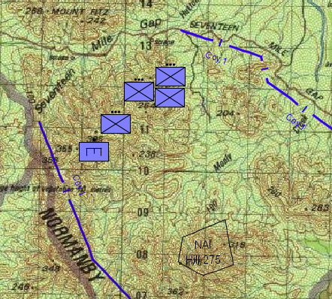
Planning
UNCLASSIFIED
Plan B
Needs Improvement
Plan A
Plan C
Notes:
Need to merge into the one game, either one at a time or all working on own copy and then software support to merge them all together.

Slide 26
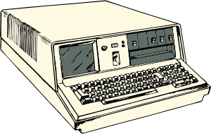
Planning
UNCLASSIFIED
Plan A
Plan B
Plan C
Notes:
Need to merge into the one game, either one at a time or all working on own copy and then software support to merge them all together.

Slide 27
Wargaming
UNCLASSIFIED
Operator
Subject
Matter
Expert
Adjudicator
Red
Commander
Facilitator
Blue
Commaner
Analyst

Slide 28
Wargaming
UNCLASSIFIED
Operator
Subject
Matter
Expert
Needs Improvement
Adjudicator
Red
Commander
Facilitator
Blue
Commaner
Analyst

Slide 29
Wargaming
UNCLASSIFIED
Operator
A
Analyst
Notes:
Improvement is extra players can now annotate context directly and can update each others annotation. More data direct from participants with domain knowledge and more capture points.

Slide 30
Collaboration Improvements
UNCLASSIFIED
Direct interface to tool
Shared data environment
More captured data
Better analysis

Slide 31
Goal
UNCLASSIFIED
Simple data entry
Notes:
Things from this point on can be skipped over depending on how time is going

Slide 32
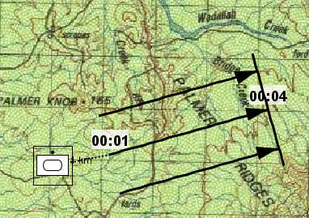
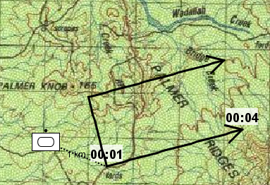
Changing Graphics
UNCLASSIFIED
Decided to Bypass instead of Clear
Needs Improvement
Select Bypass graphic
Draw over old graphic (or manually enter location)
Delete old graphic
Reset unit to plan connection

Slide 33
Changing Graphics
UNCLASSIFIED
Rename
Task
Line
Delete
Bypass
Clear

Slide 34
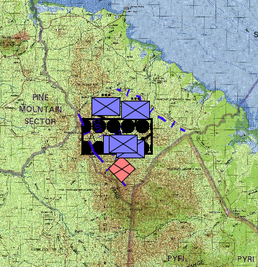
Icon zoom
UNCLASSIFIED
Needs Improvement
Zoom Out

Slide 35
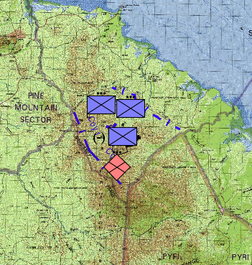
Icon Zoom
UNCLASSIFIED
Cluttered
Decluttered

Slide 36
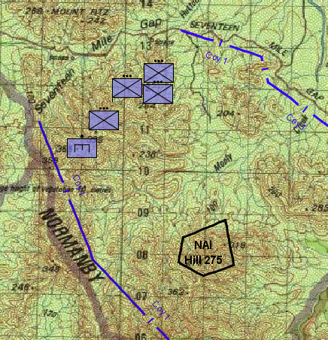
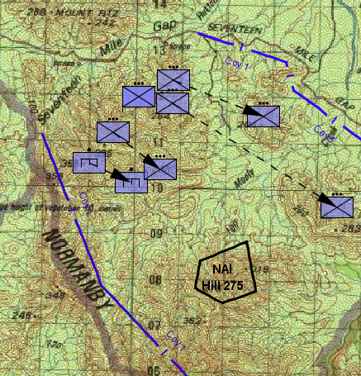
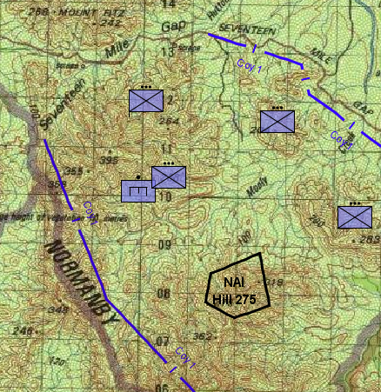
Event Planning
UNCLASSIFIED

Slide 37
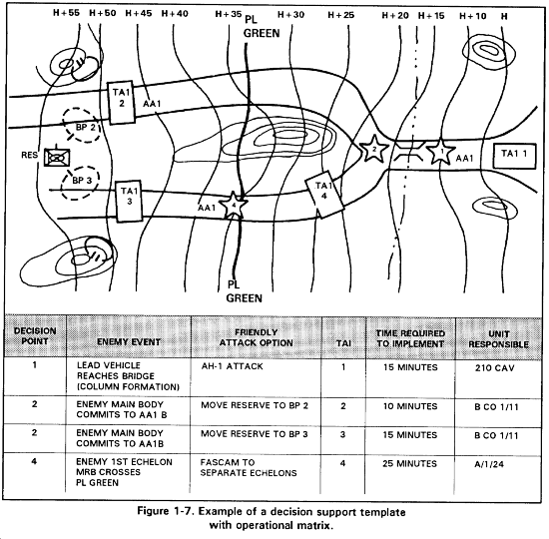
Event Planning
UNCLASSIFIED

Slide 38
Simple Data Entry
UNCLASSIFIED
Easier graphic entry
Improved graphics display
Easier movement planning
Comparison graphics
Many other small modifications…

Slide 39
Improved Seminar Wargaming Tool
UNCLASSIFIED
Lessons learnt
Keep interface simple
Allow direct entry from participants
Capture ALL the data
Notes:
Original image “Clean ALL the things” - http://hyperboleandahalf.blogspot.com.au/2010/06/this-is-why-ill-never-be-adult.html

