Slide 1
The Use of Red Teaming for Analysis
UNCLASSIFIED
Julia Piotto
(Patricia Dexter)
Land Capability Analysis
JOAD

Slide 2
Biases & Heuristics
They can lead to false assumptions and may have a detrimental effect on judgements and decisions
Cognitive
heuristics
Behavioural & Decision making Biases
“Mental shortcuts” or rules of thumb
Multi method techniques provide bias mitigation strategies
Techniques
Memory
biases
Probability & Belief biases
Social biases
There are many (over 180), not just in the field of Psychology

Slide 3
Red Teaming
UNCLASSIFIED
Red Teaming is now considered much more broadly than where it came from.
We use the following functional definition :
Any activity that analyses plans, processes, systems or equipment by using one or more alternate – typically adversarial - perspectives.
This encompasses everything from wargaming and field exercises, through the cyber domain and into the analytical activities for policy and concepts. (group discussion exercises or individual analysis).
Red teaming formally exists in military, national security, intelligence, strategy, law enforcement, business, IT, finance & economics

Slide 4
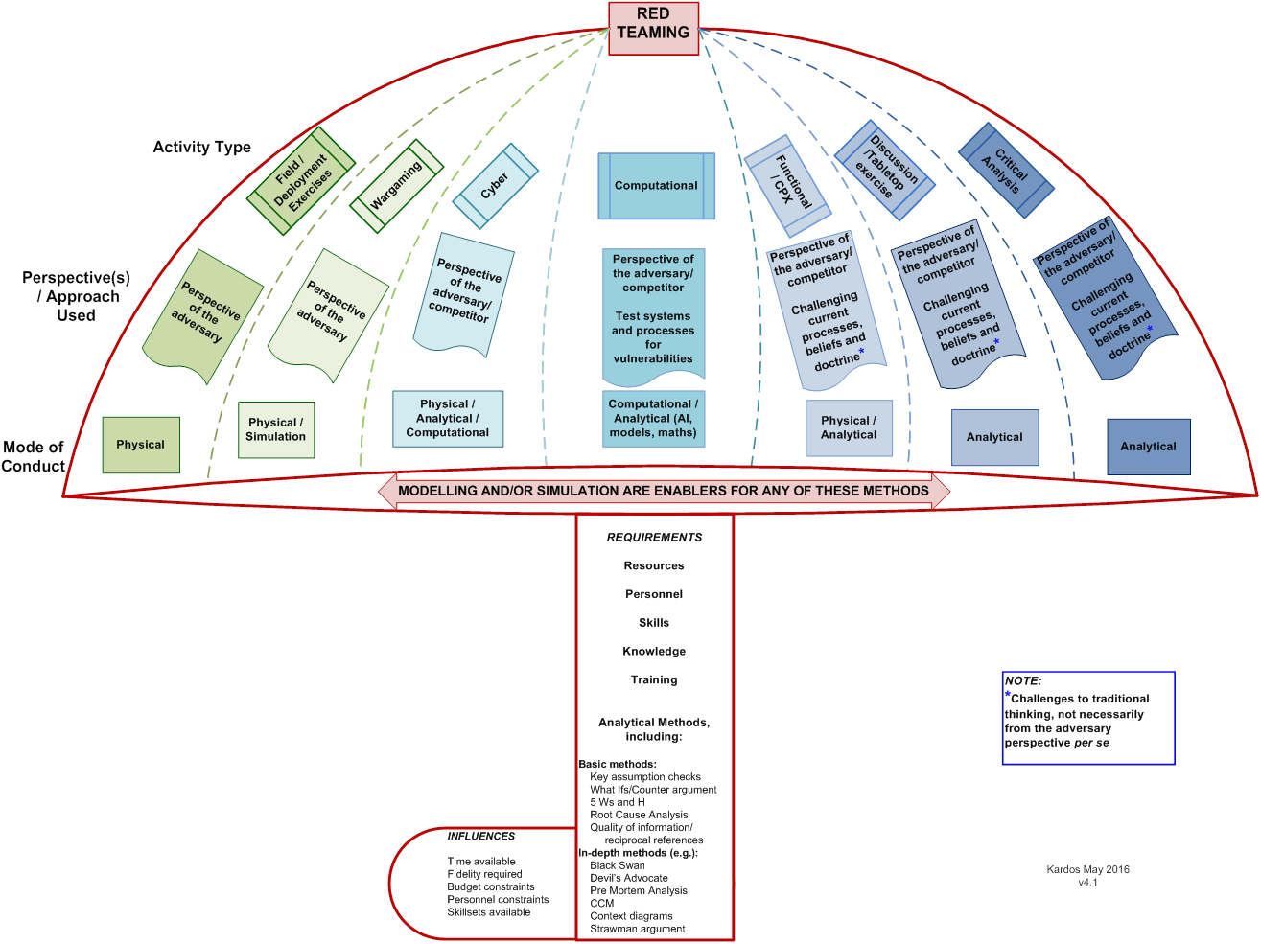
Varieties of Red Teaming
UNCLASSIFIED
NB: combinations of activity types are also possible

Slide 5
Why Red Team?
UNCLASSIFIED
Expose faulty assumptions / decisions
Challenge traditional or conventional thinking
Minimise biases / heuristics leading to poor judgement
Test & proactively challenge a system / process / decision etc.
The ultimate aim is to ensure the decisions and arguments are the most robust they can be with decision makers aware of flaws in their systems.

Slide 6
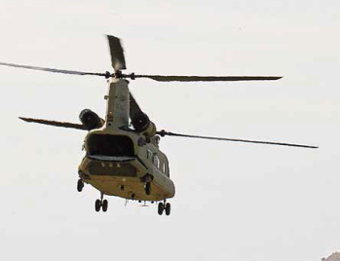
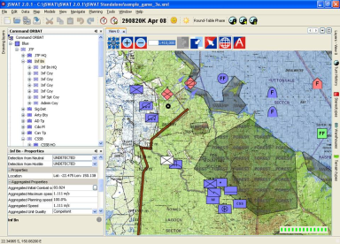
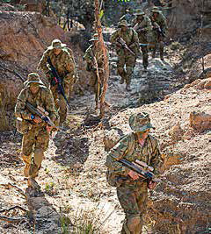
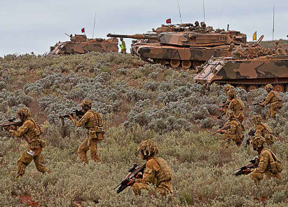
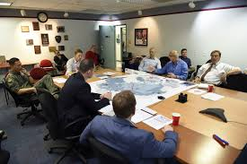
“Traditional” Field deployment/ exercises, wargaming, functional CPX
Blue / allied / actors
Live / Field
Representations
Enablers:
Models, HIL and CL simulations run with replication using seeds and adjudication tools
Active participation as the adversary and/or insertion of unexpected scenarios to challenge and test the activity and participants.
Red team

Slide 7
“Non-Traditional” – discussions, tabletop, critical analysis
Challenging and testing of arguments based on assumptions
Ideal & robust evidence based arguments/policies
Minor assumptions/issues are challenged and fail. Bulk of the argument still stands
Key assumptions don’t hold true
policy/argument /decision no longer holds when key assumptions fail
Take faulty assumptions and flawed arguments and develop sound arguments based on evidence or which withstand challenge.

Slide 8
Example – Key assumption check
UNCLASSIFIED
A fundamental questioning technique which should be applied to any problem.
Faulty critical assumption
Non robust plans
Failure
Failure
Apply Red Teaming
Assumption challenged and identified
Decision Makers choice with evidence / awareness
Success
Notes:
So if you don’t have robust checking of your assumptions then your long term FLW plans and strategies can be preparing for the wrong plan.

Slide 9
Designing and Planning
UNCLASSIFIED
Sponsor engagement
Sponsor prepared to challenge and accept outcomes
Space to be challenged/questioned/probed
Complexity & type
boundaries
Planning & Tailoring
Biases & Heuristics
methods
Red Team + others
Resources & Scale
Ground Rules
Training
Individual / team / & Face to face / distributed etc
Facilitators & delivery
participants
Data Collection
Activity/ies
Analysis & Meaning
outcomes

Slide 10
Tailoring Methods – toolbox development
UNCLASSIFIED
Core Methods
Key Assumption Check
What if?/Counter Argument
Brainstorming
Visualisation
Quality of Information
Structured analysis:
Sorting and clustering
Ranking, Scoring & Prioritising
Starbursting
Cross-Impact matrix
Morphological Analysis
Strawman
Force field analysis
SWOT or TOWS analysis
Impact matrix
Scenario analysis
Indicators & validators
Hypothesis generation
Diagnostic reasoning
Analysis of competing hypotheses
Enabling Techniques:
Critical thinking
Nominal Group
Delphi method
Modelling & Simulation
Challenge analysis:
Structured analogies
Role playing
Red hat analysis
Outside-in thinking
Adversarial collaboration
Structured debate
Deception detection
Red team analysis
Premortem analysis
Structured self-critique
High impact/low probability analysis
Devils advocacy
Focussing the context and problem:
AIMS (Audience, Issue, Message & Storyline)
Customer Checklist
Issue Redefinition
Who, What, where, when, How & why
Root Cause Analysis – 5 Whys

Slide 11
Step 1 - Facilitated Discussion
UNCLASSIFIED
Core Methods
Key Assumption Check
What if?/Counter Argument
Brainstorming
Visualisation
Quality of Information
Structured analysis:
Sorting and clustering
Ranking, Scoring & Prioritising
Starbursting
Cross-Impact matrix
Morphological Analysis
Strawman
Force field analysis
SWOT or TOWS analysis
Impact matrix
Scenario analysis
Indicators & validators
Hypothesis generation
Diagnostic reasoning
Analysis of competing hypotheses
Enabling Techniques:
Critical thinking
Nominal Group
Delphi method
Modelling & Simulation
Challenge analysis:
Structured analogies
Role playing
Red hat analysis
Outside-in thinking
Adversarial collaboration
Structured debate
Deception detection
Red team analysis
Premortem analysis
Structured self-critique
High impact/low probability analysis
Devils advocacy
Focussing the context and problem:
AIMS (Audience, Issue, Message & Storyline)
Customer Checklist
Issue Redefinition
Who, What, where, when, How & why
Root Cause Analysis – 5 Whys

Slide 12
Step 2 – Multi Stage Thematic Analysis
UNCLASSIFIED
Core Methods
Key Assumption Check
What if?/Counter Argument
Brainstorming
Visualisation
Quality of Information
Structured analysis:
Sorting and clustering
Ranking, Scoring & Prioritising
Starbursting
Cross-Impact matrix
Morphological Analysis
Strawman
Force field analysis
SWOT or TOWS analysis
Impact matrix
Scenario analysis
Indicators & validators
Hypothesis generation
Diagnostic reasoning
Analysis of competing hypotheses
Enabling Techniques:
Critical thinking
Nominal Group
Delphi method
Modelling & Simulation
Challenge analysis:
Structured analogies
Role playing
Red hat analysis
Outside-in thinking
Adversarial collaboration
Structured debate
Deception detection
Red team analysis
Premortem analysis
Structured self-critique
High impact/low probability analysis
Devils advocacy
Focussing the context and problem:
AIMS (Audience, Issue, Message & Storyline)
Customer Checklist
Issue Redefinition
Who, What, where, when, How & why
Root Cause Analysis – 5 Whys

Slide 13
Step 3 – Actor, Goal and Causal Analysis
UNCLASSIFIED
Core Methods
Key Assumption Check
What if?/Counter Argument
Brainstorming
Visualisation
Quality of Information
Structured analysis:
Sorting and clustering
Ranking, Scoring & Prioritising
Starbursting
Cross-Impact matrix
Morphological Analysis
Strawman
Force field analysis
SWOT or TOWS analysis
Impact matrix
Scenario analysis
Indicators & validators
Hypothesis generation
Diagnostic reasoning
Analysis of competing hypotheses
Enabling Techniques:
Critical thinking
Nominal Group
Delphi method
Modelling & Simulation
Challenge analysis:
Structured analogies
Role playing
Red hat analysis
Outside-in thinking
Adversarial collaboration
Structured debate
Deception detection
Red team analysis
Premortem analysis
Structured self-critique
High impact/low probability analysis
Devils advocacy
Focussing the context and problem:
AIMS (Audience, Issue, Message & Storyline)
Customer Checklist
Issue Redefinition
Who, What, where, when, How & why
Root Cause Analysis – 5 Whys

Slide 14
Step 4 – Options Capture
UNCLASSIFIED
Core Methods
Key Assumption Check
What if?/Counter Argument
Brainstorming
Visualisation
Quality of Information
Structured analysis:
Sorting and clustering
Ranking, Scoring & Prioritising
Starbursting
Cross-Impact matrix
Morphological Analysis
Strawman
Force field analysis
SWOT or TOWS analysis
Impact matrix
Scenario analysis
Indicators & validators
Hypothesis generation
Diagnostic reasoning
Analysis of competing hypotheses
Enabling Techniques:
Critical thinking
Nominal Group
Delphi method
Modelling & Simulation
Challenge analysis:
Structured analogies
Role playing
Red hat analysis
Outside-in thinking
Adversarial collaboration
Structured debate
Deception detection
Red team analysis
Premortem analysis
Structured self-critique
High impact/low probability analysis
Devils advocacy
Focussing the context and problem:
AIMS (Audience, Issue, Message & Storyline)
Customer Checklist
Issue Redefinition
Who, What, where, when, How & why
Root Cause Analysis – 5 Whys

Slide 15
Step 5 – Series of Surveys
UNCLASSIFIED
Core Methods
Key Assumption Check
What if?/Counter Argument
Brainstorming
Visualisation
Quality of Information
Structured analysis:
Sorting and clustering
Ranking, Scoring & Prioritising
Starbursting
Cross-Impact matrix
Morphological Analysis
Strawman
Force field analysis
SWOT or TOWS analysis
Impact matrix
Scenario analysis
Indicators & validators
Hypothesis generation
Diagnostic reasoning
Analysis of competing hypotheses
Enabling Techniques:
Critical thinking
Nominal Group
Delphi method
Modelling & Simulation
Challenge analysis:
Structured analogies
Role playing
Red hat analysis
Outside-in thinking
Adversarial collaboration
Structured debate
Deception detection
Red team analysis
Premortem analysis
Structured self-critique
High impact/low probability analysis
Devils advocacy
Focussing the context and problem:
AIMS (Audience, Issue, Message & Storyline)
Customer Checklist
Issue Redefinition
Who, What, where, when, How & why
Root Cause Analysis – 5 Whys

Slide 16
Step 6 – Thematic Analysis of Solutions
UNCLASSIFIED
Core Methods
Key Assumption Check
What if?/Counter Argument
Brainstorming
Visualisation
Quality of Information
Structured analysis:
Sorting and clustering
Ranking, Scoring & Prioritising
Starbursting
Cross-Impact matrix
Morphological Analysis
Strawman
Force field analysis
SWOT or TOWS analysis
Impact matrix
Scenario analysis
Indicators & validators
Hypothesis generation
Diagnostic reasoning
Analysis of competing hypotheses
Enabling Techniques:
Critical thinking
Nominal Group
Delphi method
Modelling & Simulation
Challenge analysis:
Structured analogies
Role playing
Red hat analysis
Outside-in thinking
Adversarial collaboration
Structured debate
Deception detection
Red team analysis
Premortem analysis
Structured self-critique
High impact/low probability analysis
Devils advocacy
Focussing the context and problem:
AIMS (Audience, Issue, Message & Storyline)
Customer Checklist
Issue Redefinition
Who, What, where, when, How & why
Root Cause Analysis – 5 Whys

Slide 17
All Techniques Used in Example
UNCLASSIFIED
Core Methods
Key Assumption Check
What if?/Counter Argument
Brainstorming
Visualisation
Quality of Information
Structured analysis:
Sorting and clustering
Ranking, Scoring & Prioritising
Starbursting
Cross-Impact matrix
Morphological Analysis
Strawman
Force field analysis
SWOT or TOWS analysis
Impact matrix
Scenario analysis
Indicators & validators
Hypothesis generation
Diagnostic reasoning
Analysis of competing hypotheses
Enabling Techniques:
Critical thinking
Nominal Group
Delphi method
Modelling & Simulation
Challenge analysis:
Structured analogies
Role playing
Red hat analysis
Outside-in thinking
Adversarial collaboration
Structured debate
Deception detection
Red team analysis
Premortem analysis
Structured self-critique
High impact/low probability analysis
Devils advocacy
Focussing the context and problem:
AIMS (Audience, Issue, Message & Storyline)
Customer Checklist
Issue Redefinition
Who, What, where, when, How & why
Root Cause Analysis – 5 Whys

Slide 18
Questions?
Patricia Dexter | patricia.dexter@dsto.defence.gov.au | (08) 7389 7907
Julia Piotto | julia.piotto@dsto.defence.gov.au | (08) 7389 5736
Zenko, M (2015). Red Team: how to succeed by thinking like the enemy. Basic Books: New York.
Pherson, K.H. & Pherson, R.H. (2013). Critical Thinking for Strategic Intelligence. SAGE Press
Heuer, R.J. Jr & Pherson, R.H. (2015). Structured Analytical Techniques for Intelligence Analysis. 2nd Edition. SAGE Press

